Slide 1

AI-Powered Handwritten Answer Sheet Evaluation System
by
R.LIKHITHA
Roll No. 224G1A0541
M.SUNITHA
Roll No. 224G1A05B0
P.PRATHIBHA
Roll No. 224G1A0575
Under the guidance of
Mr. C. Sudheer Kumar, M.Tech, (Ph.D)
Assistant Professor
Department of Computer Science and Engineering
Srinivasa Ramanujan Institute of Technology
Autonomous
Rotarypuram Village, B K Samudram Mandal, Ananthapuramu – 515701.
2025-2026

Slide 2

Contents
Title Justification
Abstract
Problem statement
Objectives of Project
Literature survey for objectives
Proposed Work -(Methods to be followed for proposed system)
References
GitHub Link
Queries

Slide 3
Title Justification
The title highlights the use of Artificial Intelligence for automated evaluation.
It clearly indicates that handwritten answer sheets are the input.
The term evaluation represents automatic and objective grading.
The title reflects the use of OCR for text extraction.
It emphasizes NLP and Machine Learning for understanding answer meaning.
Overall, the title accurately describes the purpose and functionality of the project.

Slide 4
Abstract
Rapid growth of digital education and online examinations requires automated evaluation of handwritten answers.
Manual evaluation is time-consuming, inconsistent, and prone to human bias.
To develop an AI-powered system for automatic and objective evaluation of handwritten answer sheets.
Uses OCR for text extraction, NLP for semantic analysis, and Machine Learning for scoring.
Achieves faster evaluation with consistent and accurate grading.
The system improves efficiency and supports scalable assessment in modern education systems.

Slide 5
Problem Statement
The manual evaluation of handwritten answer sheets is a time-consuming and labor-intensive process that often leads to inconsistency and subjective bias in grading. With the increasing number of students and large-scale examinations, traditional evaluation methods require significant human effort and resources. Additionally, manual assessment lacks scalability and efficiency, making it unsuitable for modern digital and online examination systems. Therefore, there is a need for an automated and intelligent system that can accurately evaluate handwritten answers in a consistent, objective, and efficient manner.

Slide 6
Objectives of Project
Objective 1:
To analyze the effectiveness of OCR and NLP techniques in extracting and understanding handwritten answers.
Objective 2:
To evaluate the accuracy of machine learning models in scoring handwritten subjective answers based on semantic similarity.

Slide 7
Literature survey
1.OCR & NLP: Converts handwritten text to digital form; NLP analyzes meaning.
Key Studies:
R. Smith (2007) – Tesseract OCR for text recognition.
M. Kaur et al. (2021) – OCR + NLP for answer extraction.
2.Machine Learning Scoring: Uses ML & Transformers to evaluate semantic similarity.
Key Studies:
T. Sharma et al. (2020) – Semantic similarity for scoring.
K. Singh & R. Verma (2021) – Transformer-based scoring improves accuracy.

Slide 8
Proposed System
The proposed solution is an AI-powered automated system designed to evaluate handwritten answer sheets accurately and efficiently. The system accepts scanned handwritten answer scripts as input and applies image preprocessing techniques to enhance text quality. Optical Character Recognition (OCR) is used to convert handwritten content into machine-readable text. Natural Language Processing (NLP) techniques are then applied to preprocess and analyze the extracted text. The student answers are compared with predefined model answers using semantic similarity measures. Based on this analysis, a machine learning model assigns appropriate marks, enabling objective and consistent evaluation. This automated approach reduces manual effort, ensures uniform grading, and improves scalability for large-scale examinations.

Slide 9
References
[1] R. M. Byalal, S. K. Patil, “AI-Driven Automated Answer Script Evaluation System: A Literature Review,” Int. J. Sci. Innov. Eng., vol. 2, no. 11, pp. 1198–1201, Nov. 2025.
[2] S. Karmalkar, P. Sharma, “Autograder: Automated Handwritten Subjective Answer Evaluation System,” Int. J. Adv. Res. Comput. Commun. Eng., vol. 9, no. 10, pp. 23–27, Oct. 2025.
[3] M. A. Rahaman, H. Mahmud, “Automated Evaluation of Handwritten Answer Script Using Deep Learning Approach,” Trans. Eng. Comput. Sci., vol. 28, no. 4, pp. 1–8, 2022.
[4] S. Dyavanapally, G. Narasimham, “SmartPen: Online System for Automated Grading of Handwritten Answers using Deep Learning,” IJRaset, vol. 11, no. 5, pp. 15–21, 2025.

Slide 10
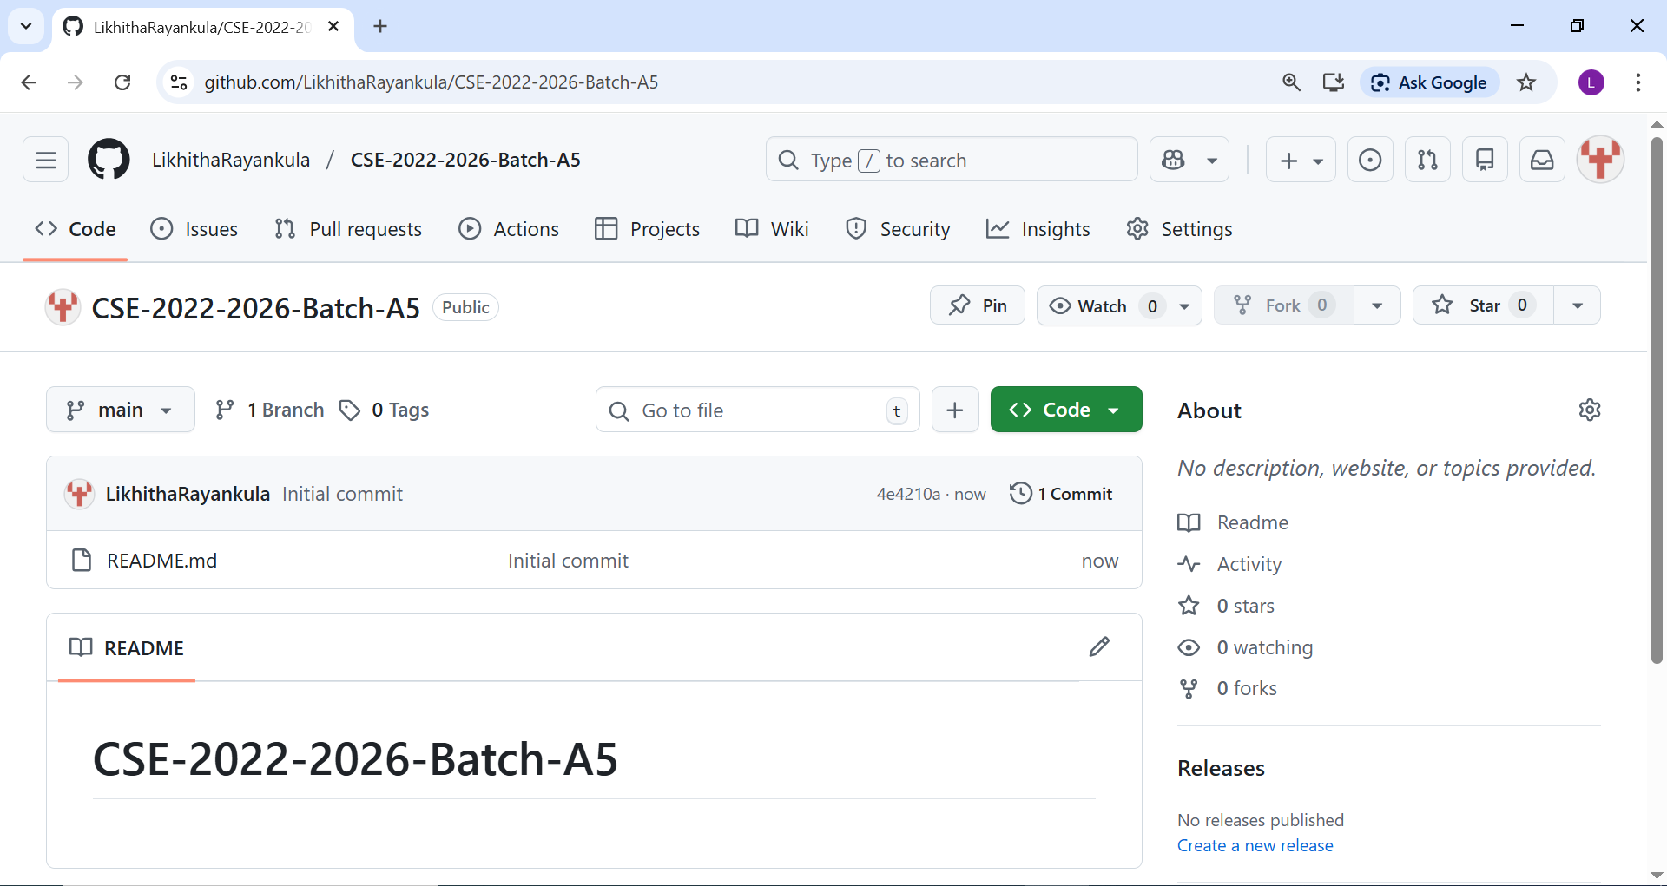
Git Hub Dashboards of each student

Slide 11
Any Queries?

